Slide 1
2 – EF Database First

Slide 2

Entity Framework
2 – Database First

Slide 3
What and Why Database First?
The database already exists
You want low level control of the database
DB is managed by DBA’s
Model changes are made in the database
Updated in the designer
Entire database can be generated from the model
Updates require a drop

Slide 4
Database first
Install AW database
Create class project
Add ADO.NET Entity Model
Point to AW database
Create model
Show the model
Coloring
Diagram partitioning
Files, edmx, .tt
POCO
Creation of navigation properties
Rename function imports

Slide 5
Conceptual model
Model metadata
Table mapping command in designer
Change property in model and show in table map
Designer based entity modeling course

Slide 6
1 – ImportAW

Slide 7
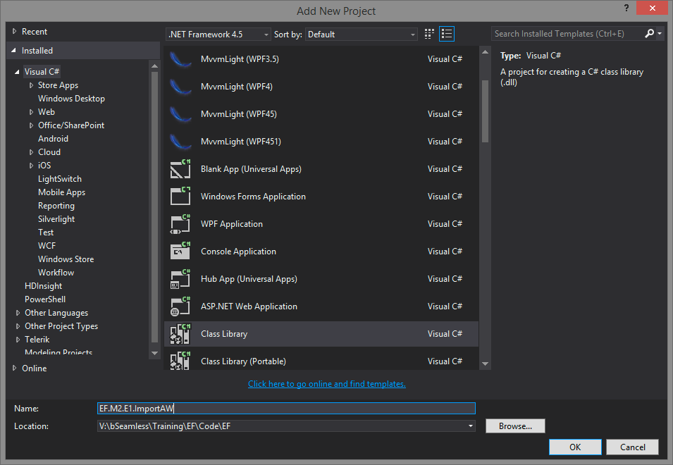
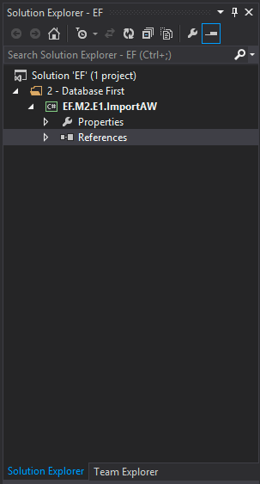
Create Solution and Class Library

Slide 8
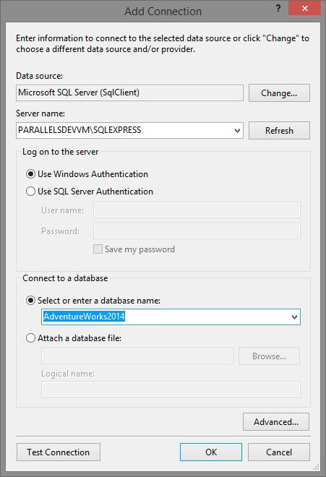

Add a Data Connection

Slide 9
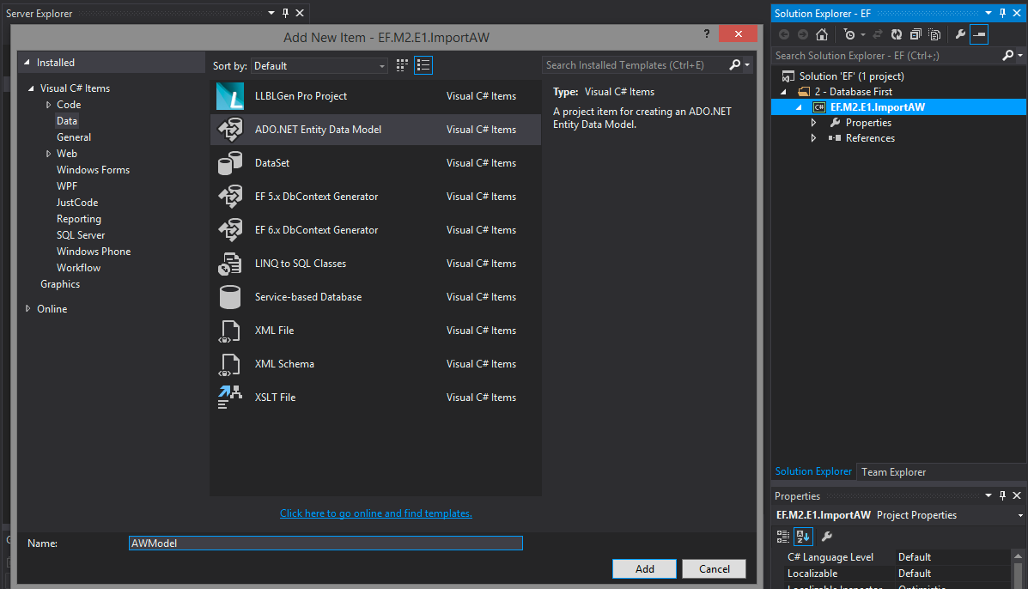
Add and ADO.NET Entity DM Item

Slide 10
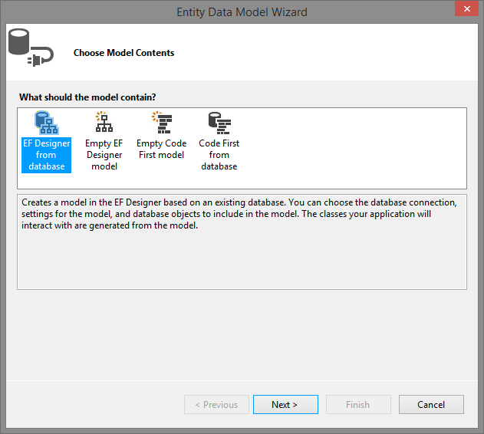
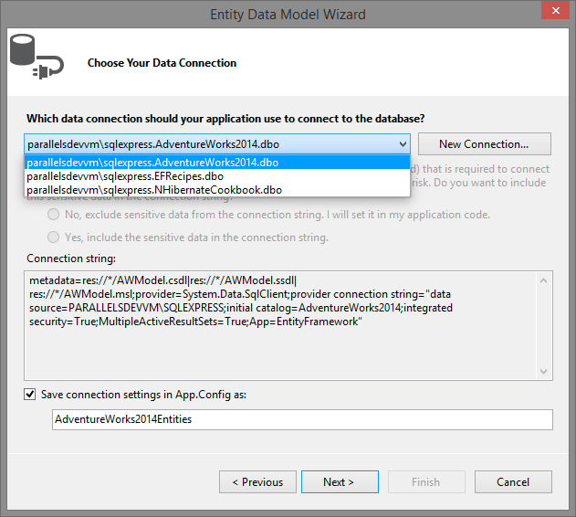
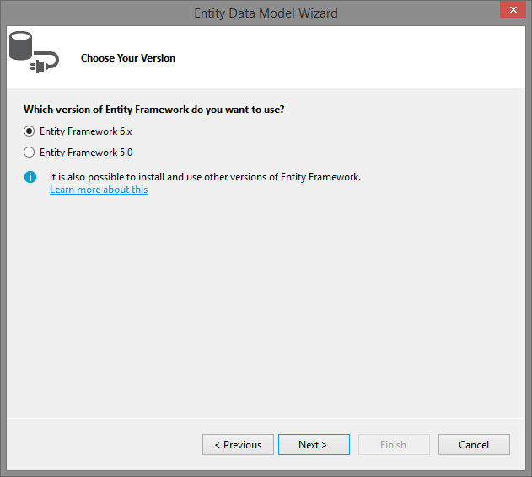
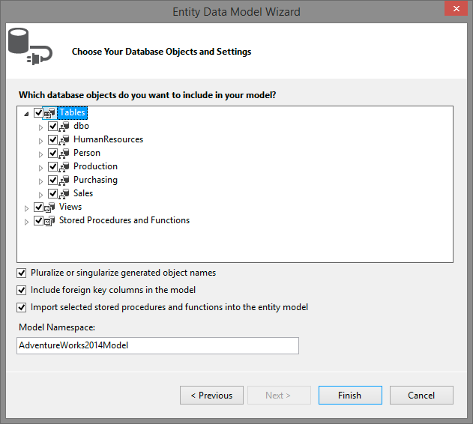
Run through the Wizard

Slide 11
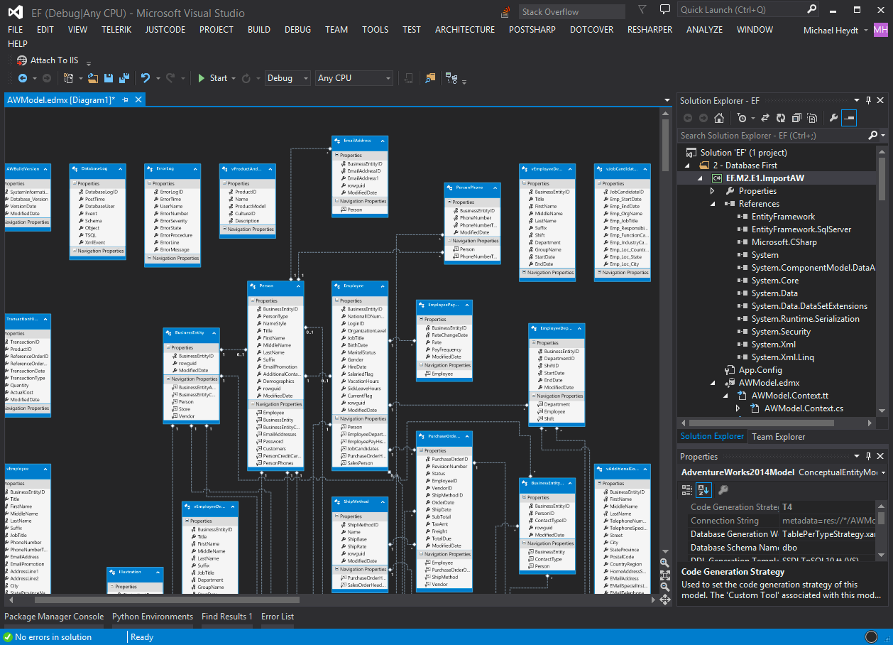
Here’s Your Model

Slide 12
Explore the Model
Entities and Relationships
App.config
Generated code

Slide 13
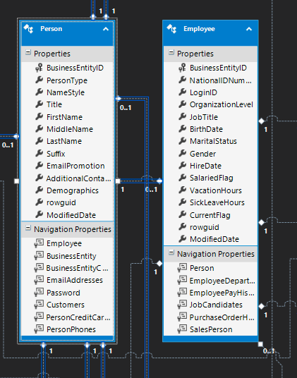
Entities Consist of:
Data Properties
Navigation Properties

Slide 14
The model class
*.edmx file
*.tt files
Model.context.tt
Model.tt
Context object in Model.Context.cs (generated)
Model.edmx.diagram
Model.edmx.diagram

Slide 15
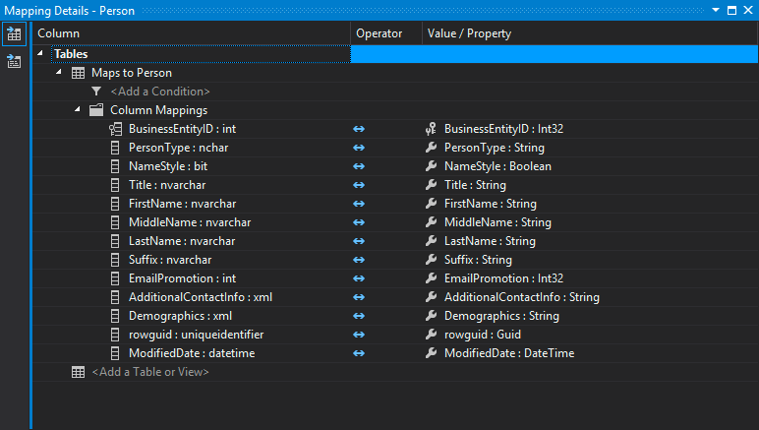
Table mappings

Slide 16
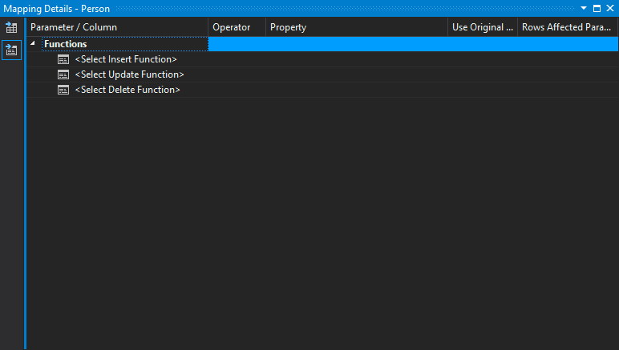
Sproc Mappings

Slide 17
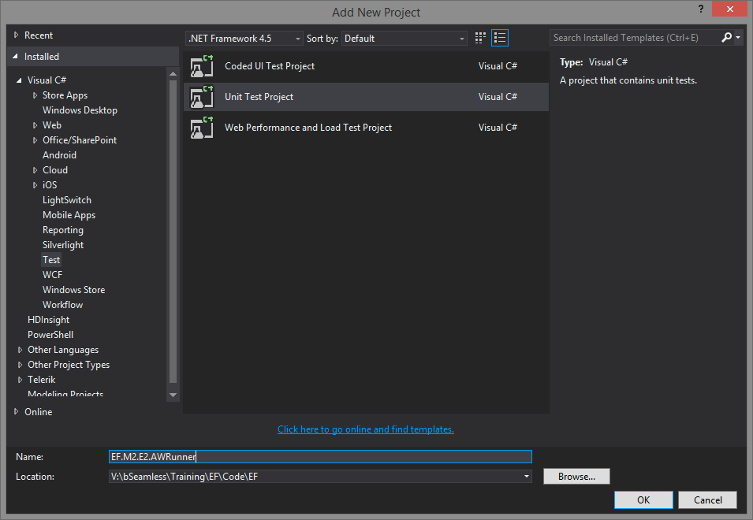
Create a Runner

Slide 18
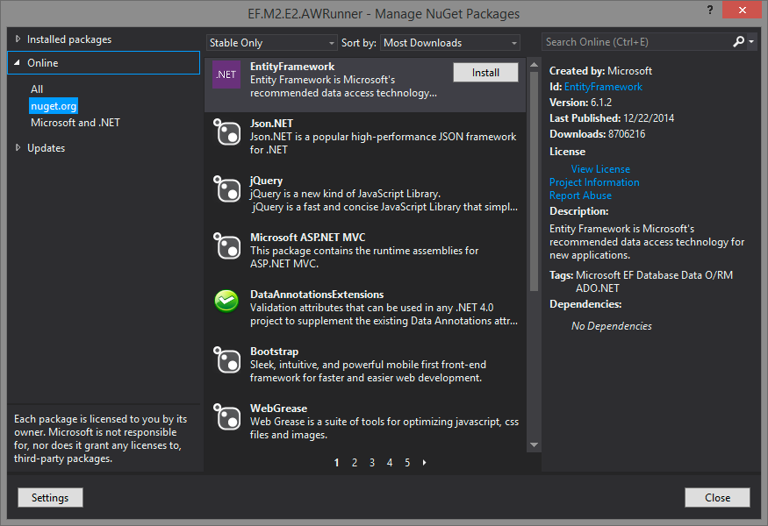
Reference EF

Slide 19
Query Employees

Slide 20
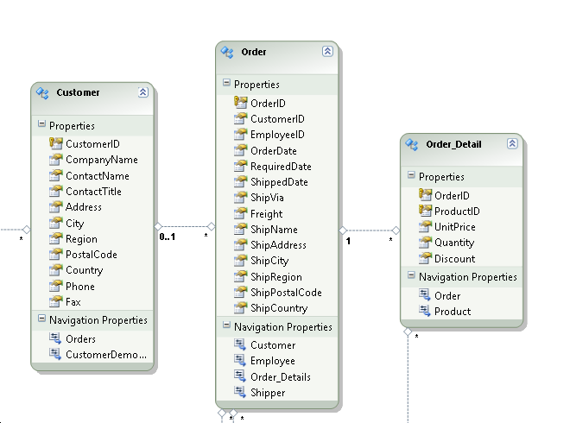
Entity in the designer
Singularization and pluralization:
The ‘many’ part is named in plural, e.g. Orders
The ‘one’ part is named in single, e.g. Customer
Navigation Properties:
Make it possible to navigate from one entity (in code an object) to another.

Slide 22
Diagramming
Create new and add entities
Removing items from a diagram
Create new diagram from selected entities

Slide 23
Update model from DB
Add a column to a table
Add new table
Update model from db option
Designer will not alter or remove existing properties
Validate model will show this
Change property type manually

Slide 24
Stored procedures
Show that function parameters are created
Results are complex types
Can remove to map to another entity
Show how to reference but not create functions
Show how to map functions like delete to stored procs

Slide 25
Enum support
Requires .net 4.5
Change ship method property to enum
Add new enum type
Specify enum values
Land, sea, air, …
Change type of ship method to the enum
Show how to use an existing enum
Enum type name must match and use reference

Slide 26
Geo modeling
Geolocation
Add it to the database table

Slide 27
Keys on views
No primary and no non-nullable, then not imported

Slide 28
Summary

Slide 29
Demo

